Slide 1
Advance Electronic I
THIRD YEAR
Lecturer: Abbas S.
Hameed
Main References:
1- Robert L. Boylestad and Louis Nashelsky, “ Circuit Theory “.
Electronic
Devices and
2- Thomas L. Floyd, “ Electronic
Devices. CCV “.
3- Adel S. Sedra and Kenneth Carless Smith, “ Microelectronic circuits “.

Slide 2
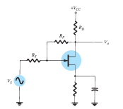
FEEDBACK AMPLIFIERS
Chapter Two Lect 6

Slide 3
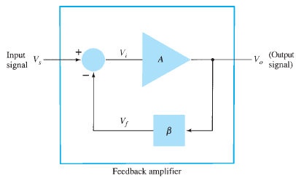
Simple block diagram of feedback amplifier
1. Higher input impedance.
3. Improved frequency response.
5. Reduced noise.
2. Better stabilized voltage gain.
4. Lower output impedance.
6. More linear operation.

Slide 4
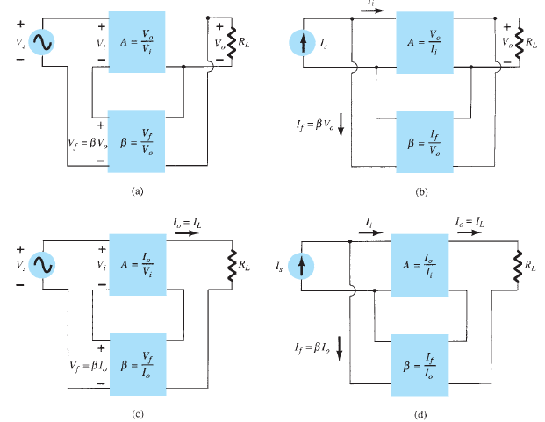
FEEDBACK CONNECTION TYPES

Slide 6
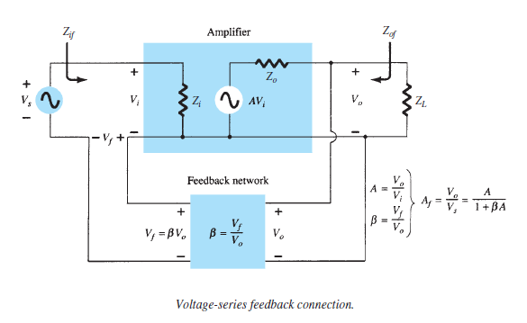
Input Impedance with Feedback

Slide 7
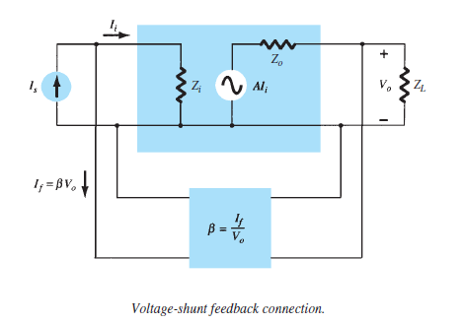
Input Impedance with Feedback

Slide 8
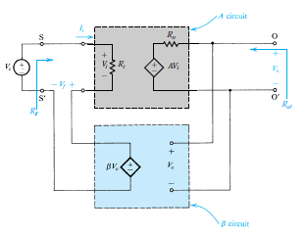
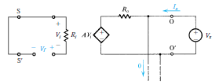
Output Impedance with Feedback
Voltage-Series Feedbac

Slide 9
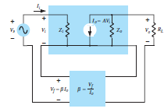
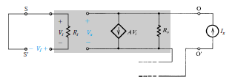
Output Impedance with Feedback
Current-Series Feedback

Slide 10
